Slide 1
Combined FEA and MBD of the foot
Ahmad Shaikh
31st Dec, 2022

Slide 2
Work done by me
FEA
Geometric Modelling
OpenSim
Explanation of the Thesis

Slide 3
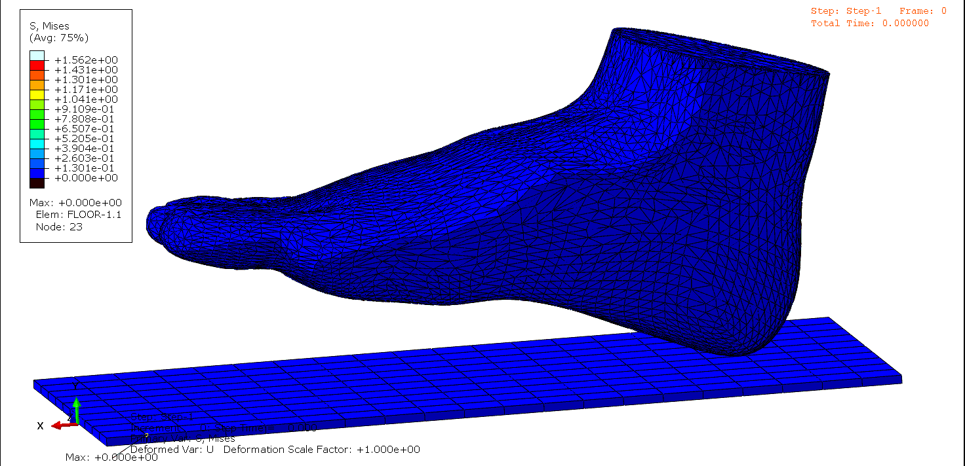
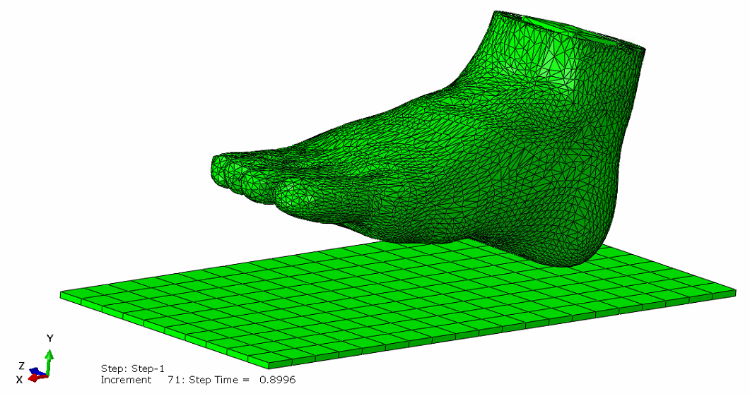
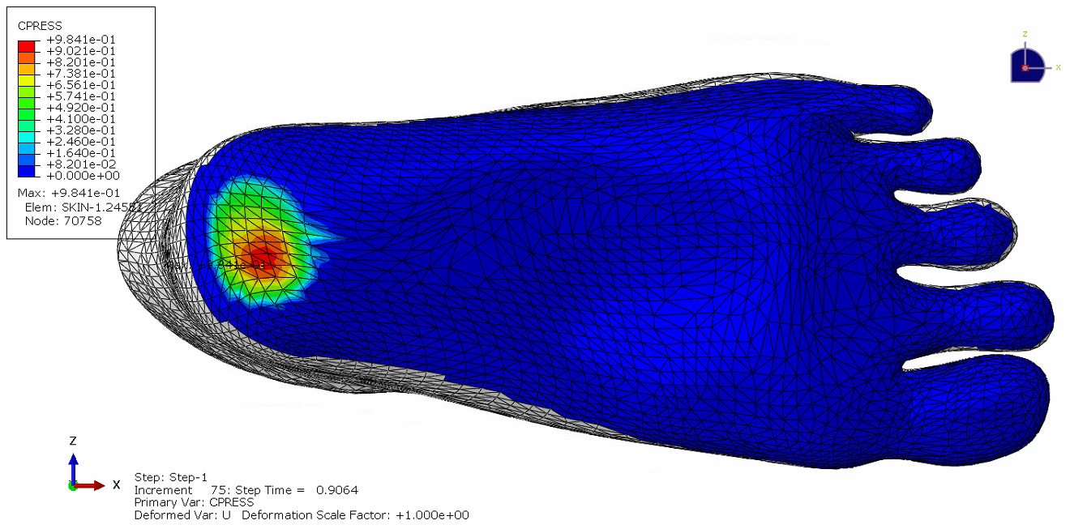
Heel Strike Simulation

Slide 4
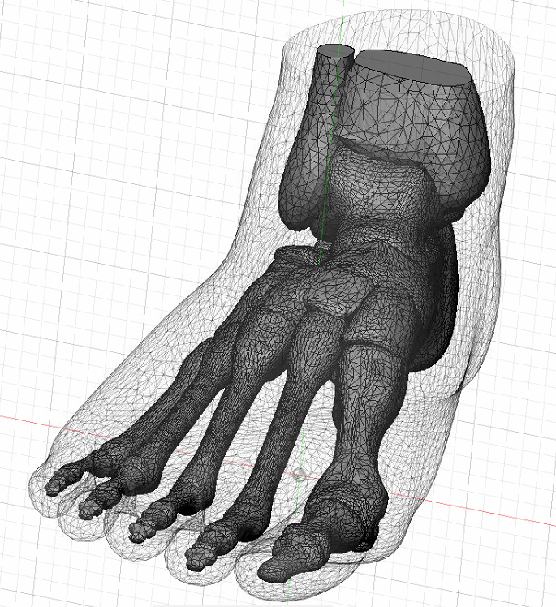
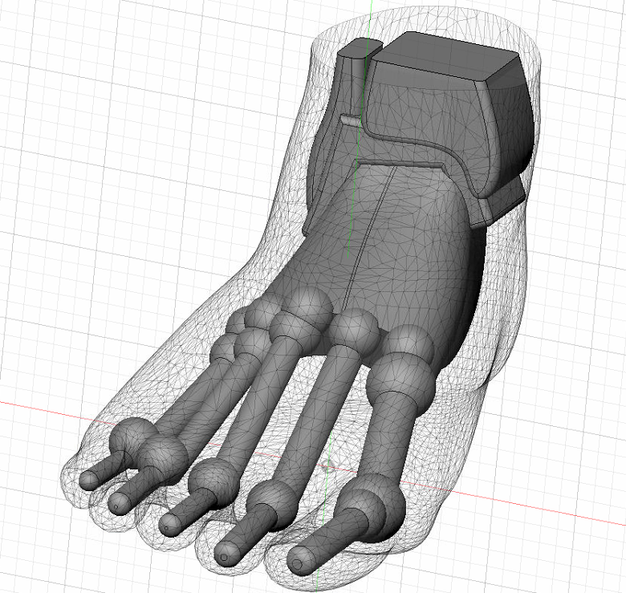
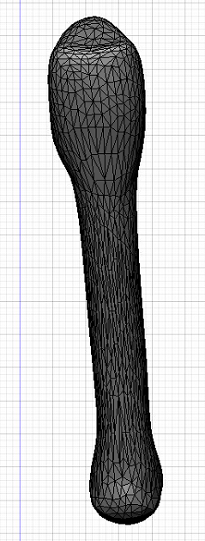
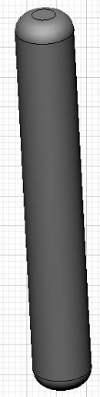
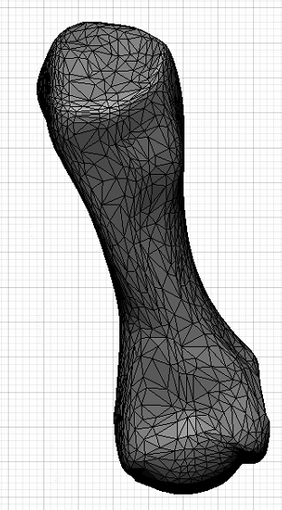
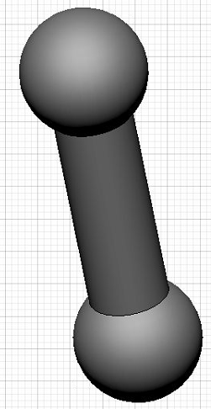
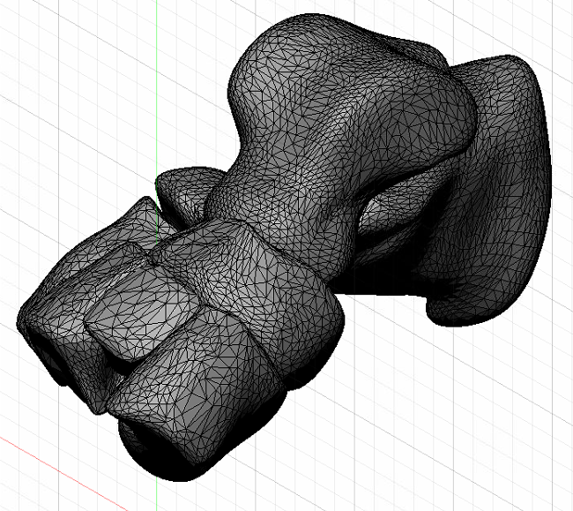
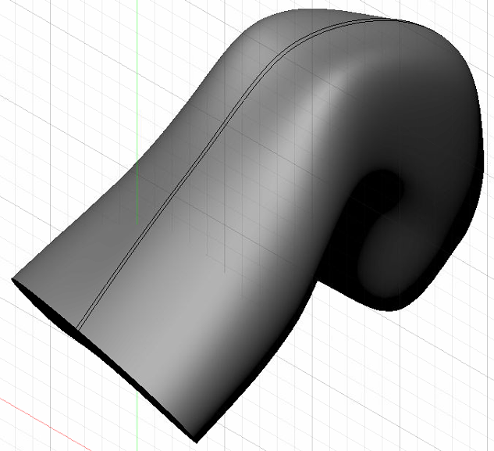
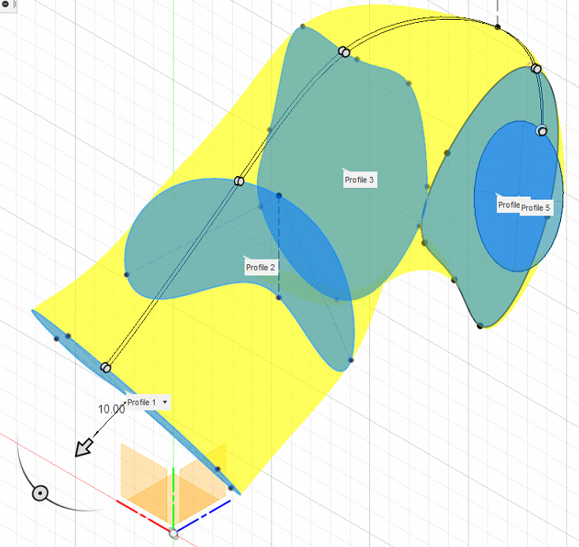
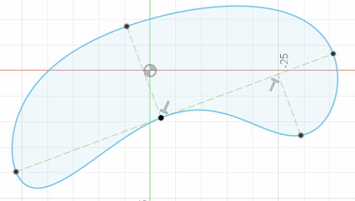
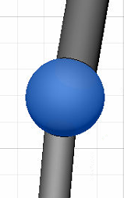
Creation of a parameterized foot model
Use of Primitives
Use of lofts and extrudes with parameterized sketches
Spherical cartilage between bones

Slide 5
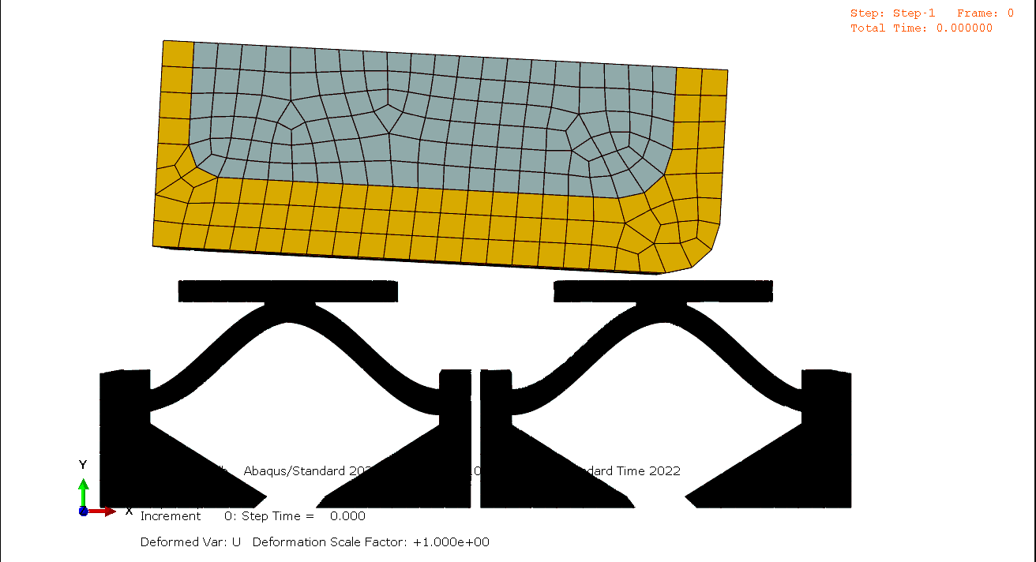
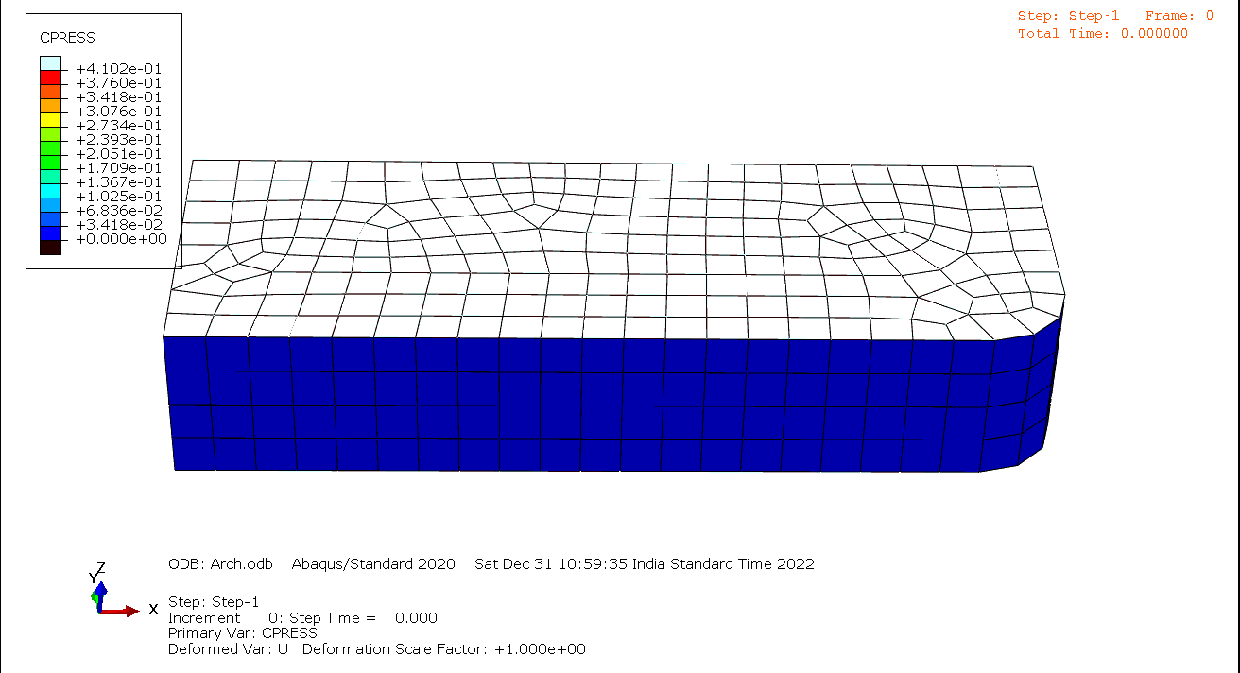
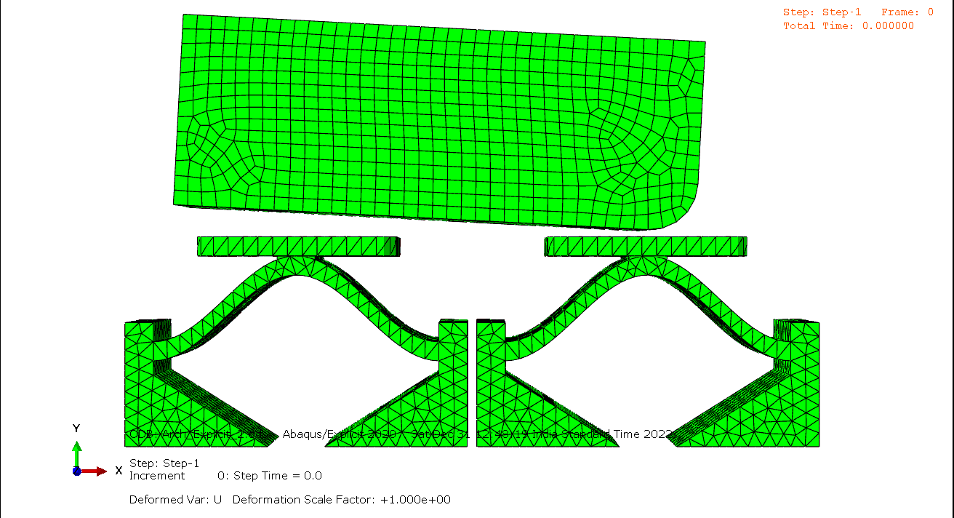
Dynamic Implicit
F
Dynamic Explicit

Slide 6
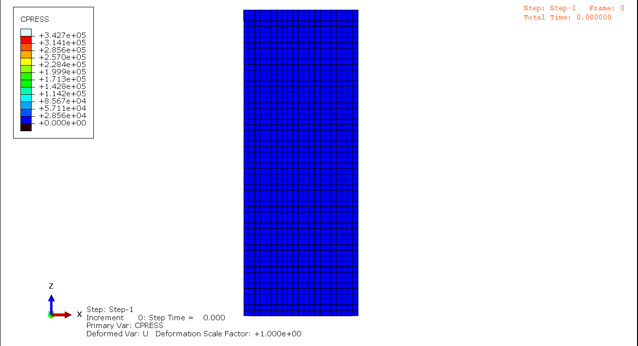
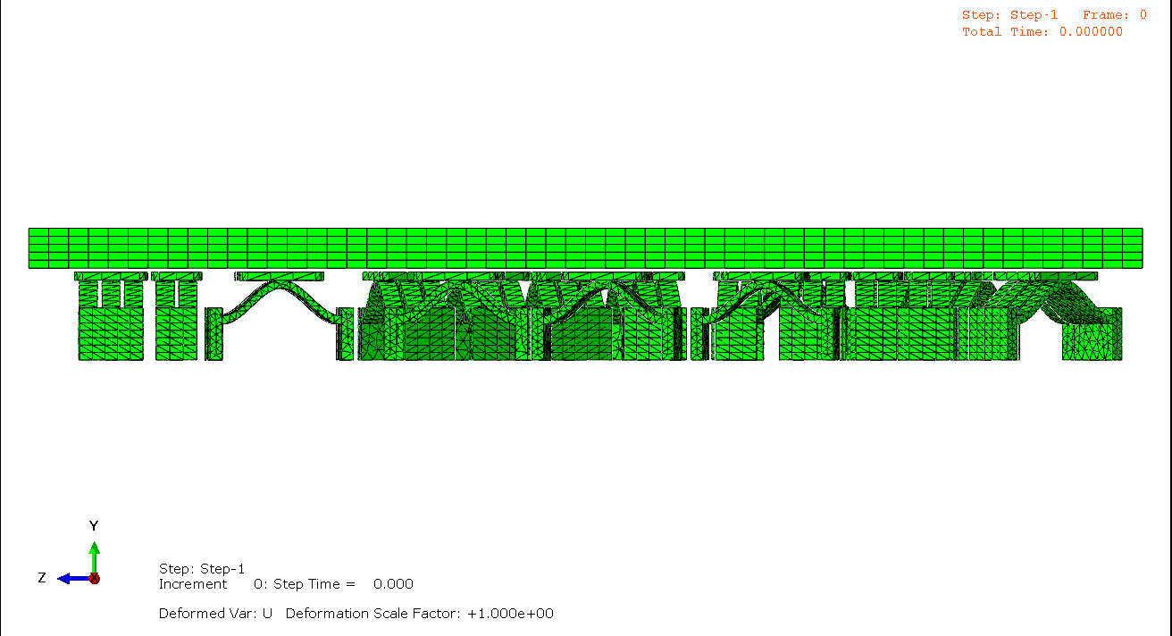

Slide 7
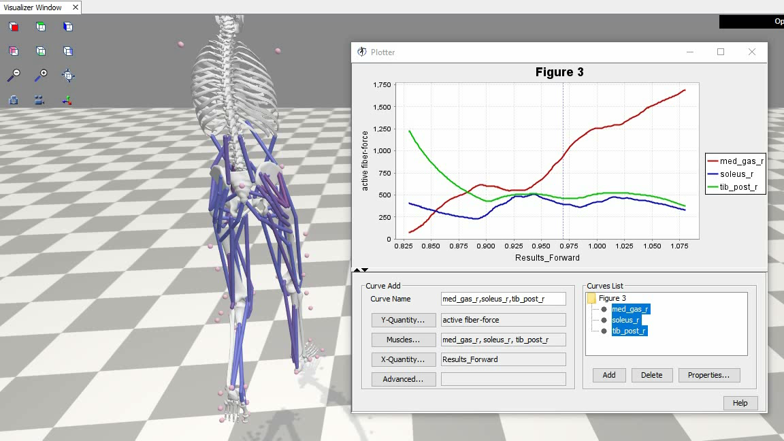
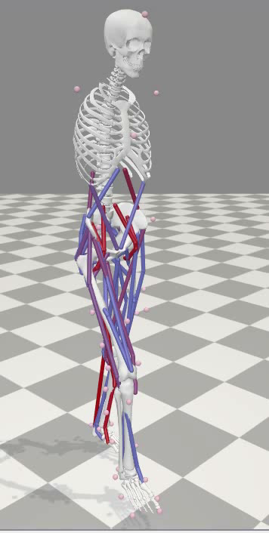

Slide 8
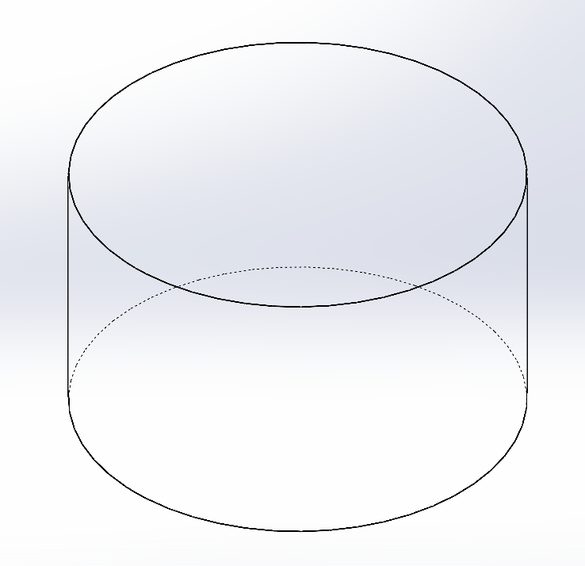
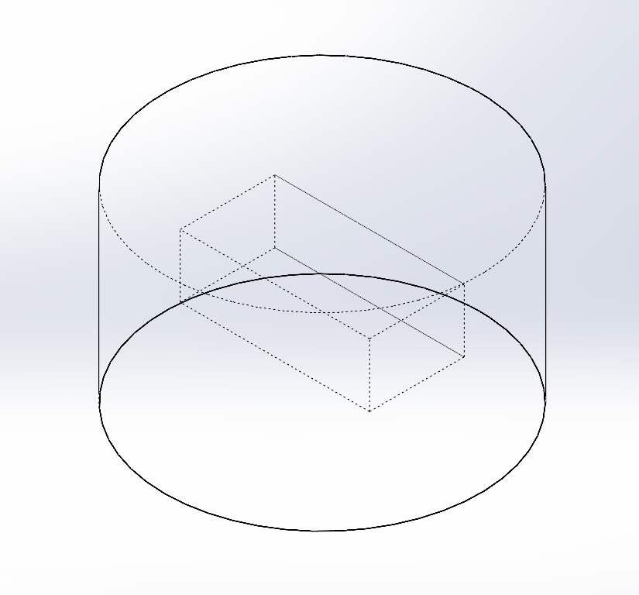
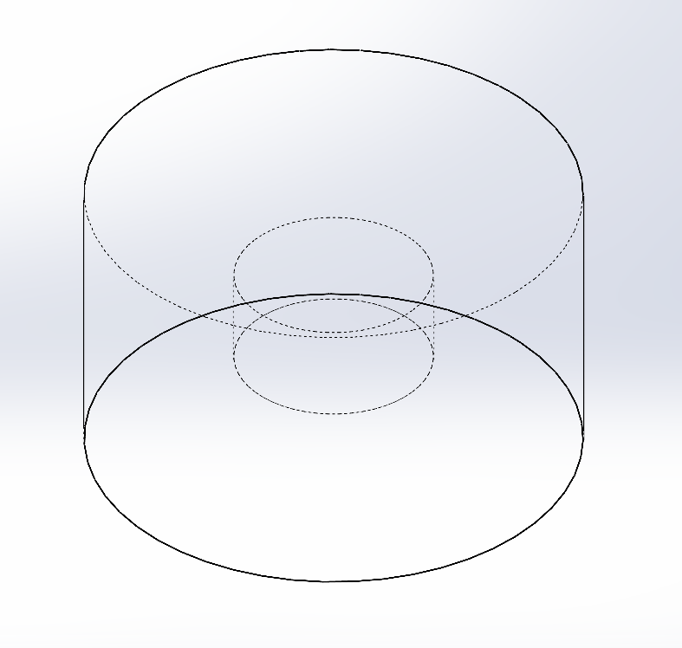
The Inverse Estimation of Structure from Plantar Pressure

Slide 9
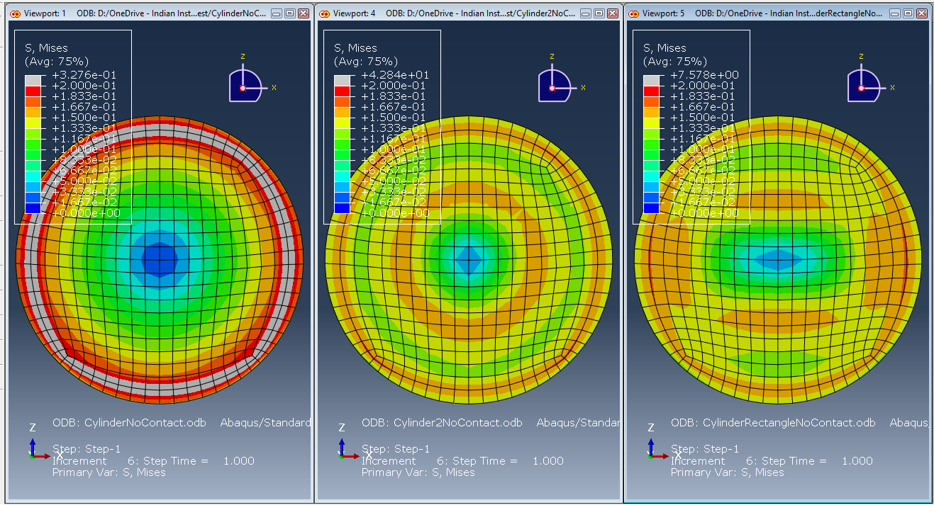

Slide 10
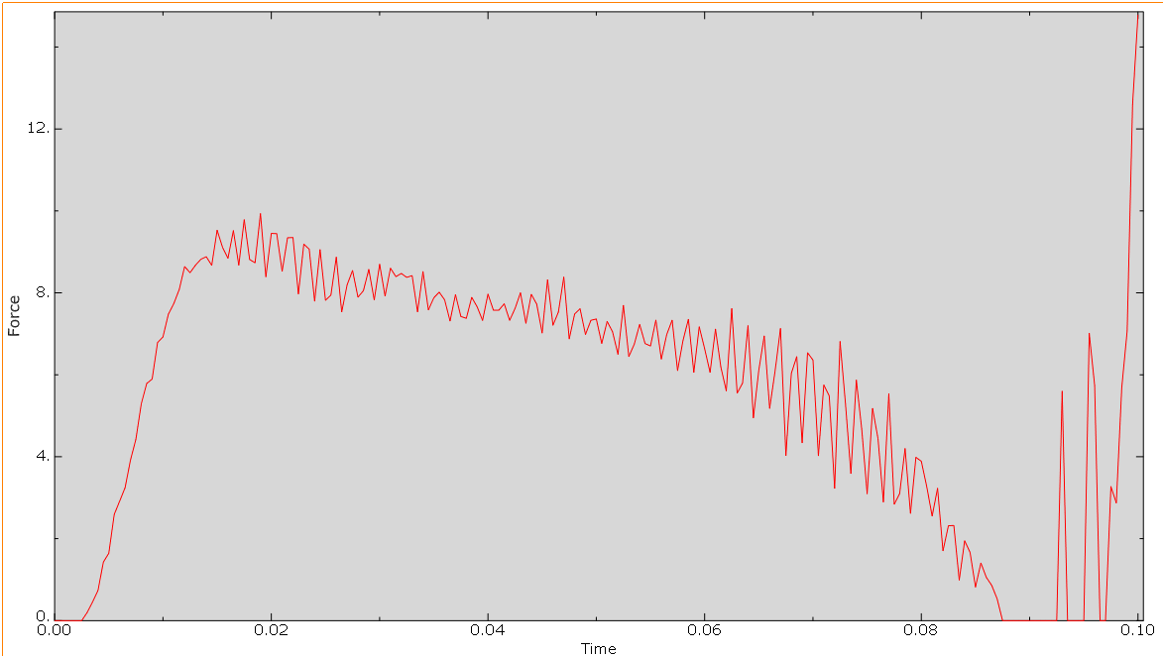
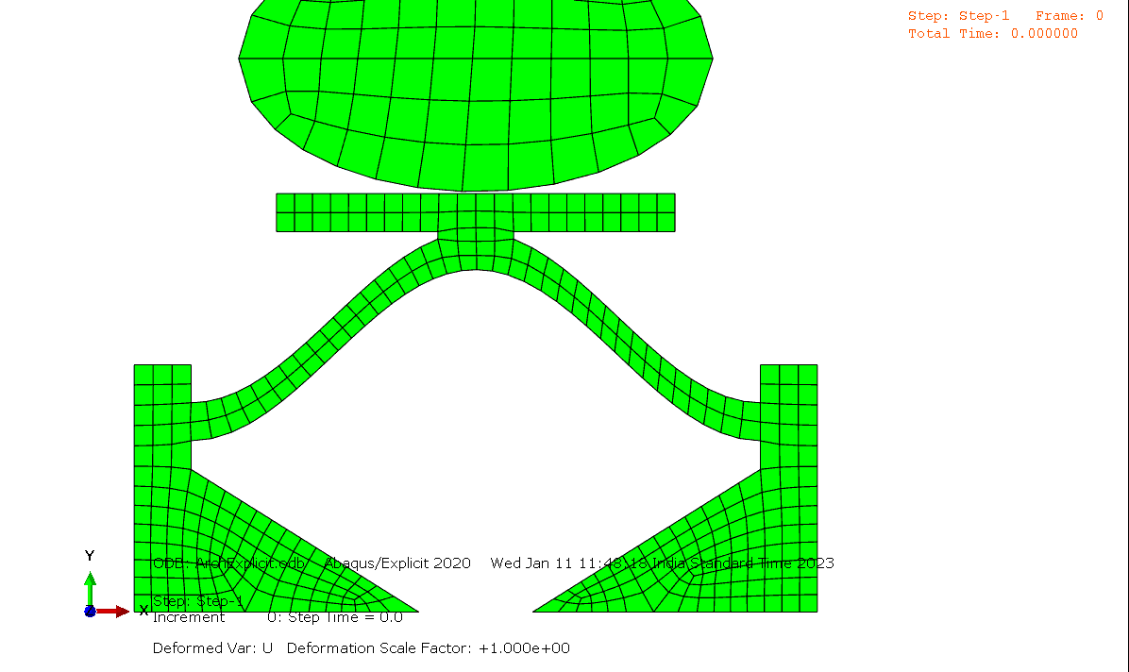

Slide 11
The general methodology used for combined mbd and fea of the foot
The current state of the art

Slide 12
Physical Experiment
Patient Details
EMG
(Optional)
Age
Weight
FEA Model
Optical Motion Capture
Linear Elastic Bones
Connected by hyperelastic cartilage
And linear elastic tendons (bar element)
Encased in a hyperelastic soft tissue
GRF
MBD Model
Rigid Bones connected by joints
+
Muscles
Relative position of foot and ground
GRF
Muscle Forces
OpenSim
Abaqus
Static study for 4-6 instances of gait
Single instance of gait
No footwear in model regardless of experiment
Behaviour of footwear
Internal stresses of the foot
Joint Moments
Joint Kinematics
Muscle Forces
Gait Study
Barefoot- control run
Footwear- immediately after wearing
Footwear- after a few months
Barefoot- after a few months

Slide 13
MultiBody dynamics

Slide 14
Physical Experiment
Patient Details
Age
Weight
FEA Model
Optical Motion Capture
EMG
(Optional)
Linear Elastic Bones
Connected by hyperelastic cartilage
And linear elastic tendons (bar element)
Encased in a hyperelastic soft tissue
GRF
MBD Model
Rigid Bones connected by joints
+
Muscles
Relative position of foot and ground
GRF
Muscle Forces
OpenSim
Abaqus
Static study for 4-6 instances of gait
Single instance of gait
No footwear in model regardless of experiment
Behaviour of footwear
Internal stresses of the foot
Joint Moments
Joint Kinematics
Muscle Forces
Gait Study
Barefoot- control run
Footwear- immediately after wearing
Footwear- after a few months
Barefoot- after a few months

Slide 15
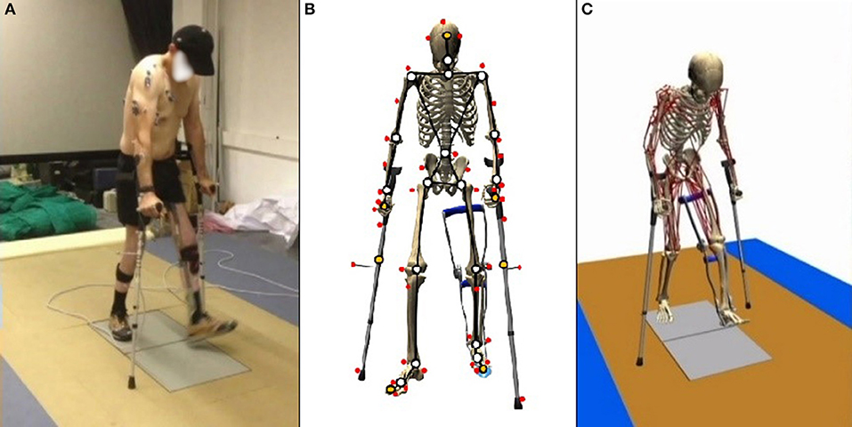
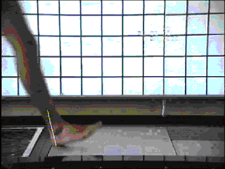
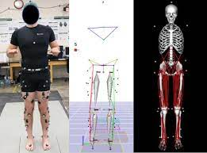
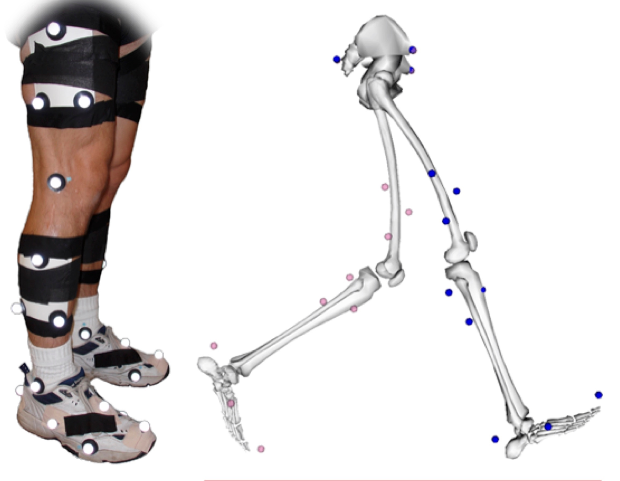
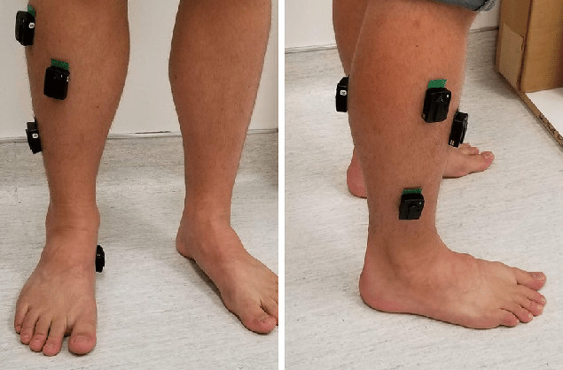
GRF
Physical Experiment
Optical Motion Capture
For simple gait, GRF of the foot is sufficient
For gait with crutches/ walkers, GRF of the crutch/ walker is also needed
EMG
Experiment marker positions must match the MBD model
Any external systems that provide an external force must also be included in the study
This is optional for regular gait. It improves the results of muscle actuation.
It is considered preferable for an impaired gait where regular muscle actuation is not observed.

Slide 16
Physical Experiment
Patient Details
Age
Weight
FEA Model
Optical Motion Capture
EMG
(Optional)
Linear Elastic Bones
Connected by hyperelastic cartilage
And linear elastic tendons (bar element)
Encased in a hyperelastic soft tissue
GRF
MBD Model
Rigid Bones connected by joints
+
Muscles
Relative position of foot and ground
GRF
Muscle Forces
OpenSim
Abaqus
Static study for 4-6 instances of gait
Single instance of gait
No footwear in model regardless of experiment
Behaviour of footwear
Internal stresses of the foot
Joint Moments
Joint Kinematics
Muscle Forces
Gait Study
Barefoot- control run
Footwear- immediately after wearing
Footwear- after a few months
Barefoot- after a few months

Slide 17
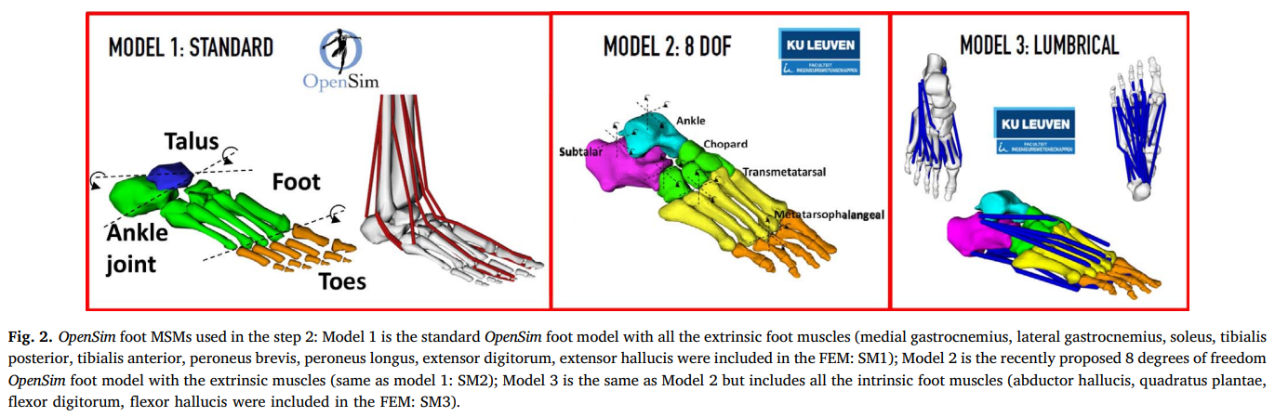
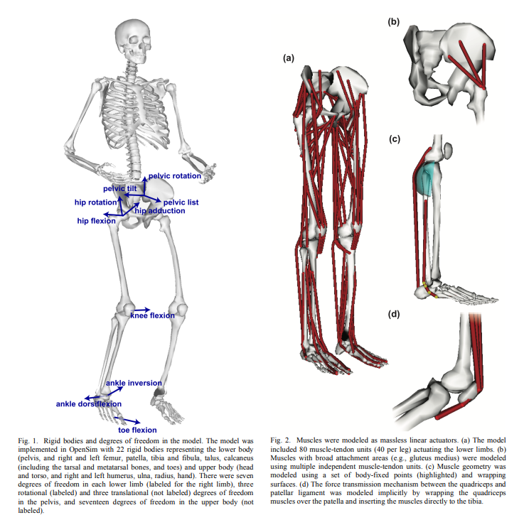
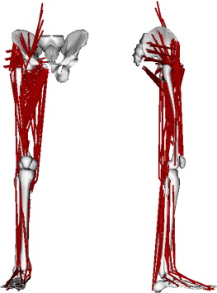
Rigid bones
Connected by Joints
Muscle actuators
Marker placement must match experiment
Degrees of freedom must be sufficient for study
Custom models can be created

Slide 18
Physical Experiment
Patient Details
Age
Weight
FEA Model
Optical Motion Capture
EMG
(Optional)
Linear Elastic Bones
Connected by hyperelastic cartilage
And linear elastic tendons (bar element)
Encased in a hyperelastic soft tissue
GRF
MBD Model
Rigid Bones connected by joints
+
Muscles
Relative position of foot and ground
GRF
Muscle Forces
OpenSim
Abaqus
Static study for 4-6 instances of gait
Single instance of gait
No footwear in model regardless of experiment
Behaviour of footwear
Internal stresses of the foot
Joint Moments
Joint Kinematics
Muscle Forces
Gait Study
Barefoot- control run
Footwear- immediately after wearing
Footwear- after a few months
Barefoot- after a few months

Slide 19
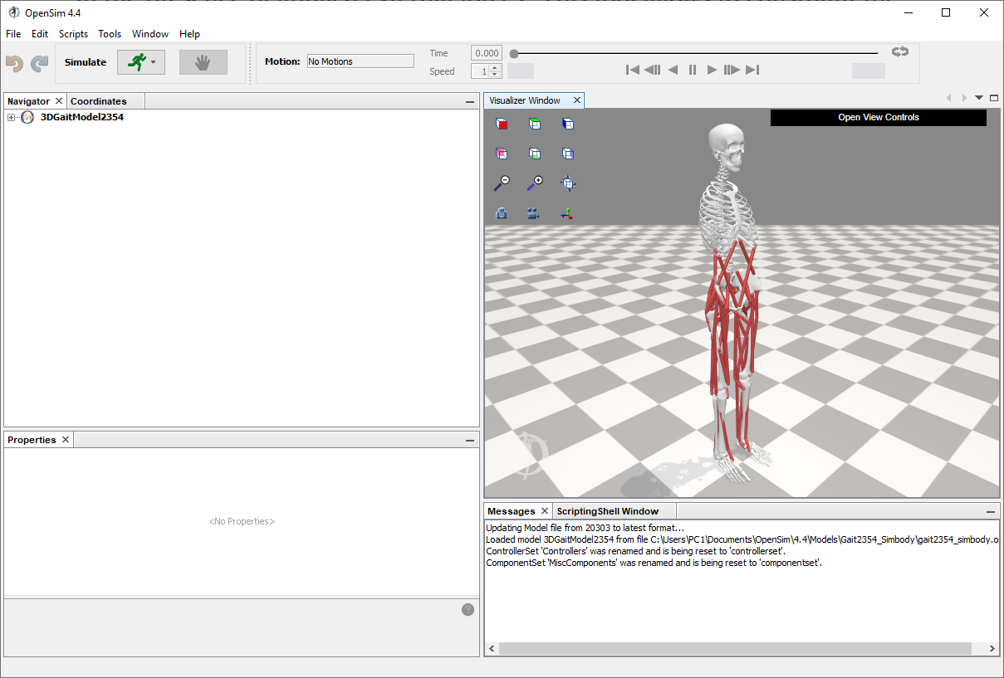
OpenSim
Scaling
Inverse Kinematics
Inverse Dynamics
Static Optimization
Computer Muscles Control
Age
Weight
GRF
EMG
(Optional)
Optical Motion Capture

Slide 20
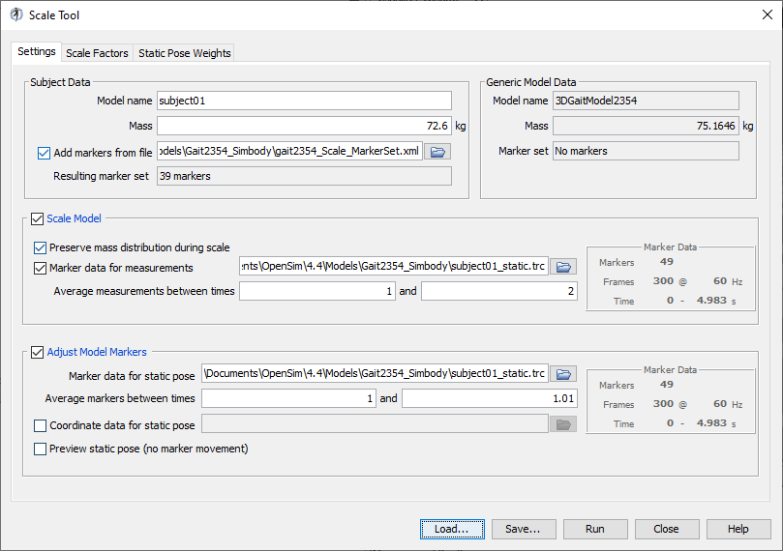
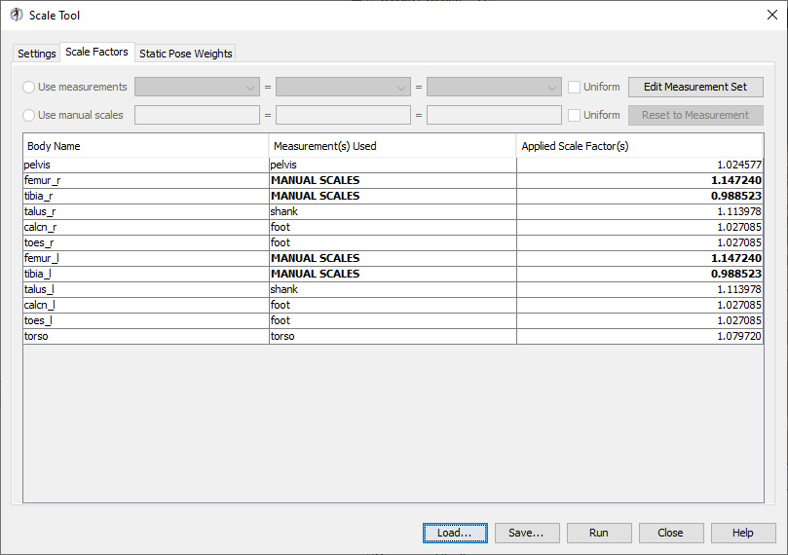
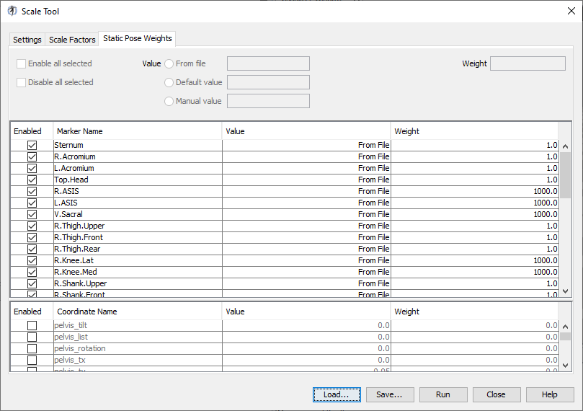
Scaling
Involves the scaling of the MBD model to the anthropometric measures of the subject
Uses distance between markers (an output of the motion capture experiment) or by manually specifying scale factors

Slide 21
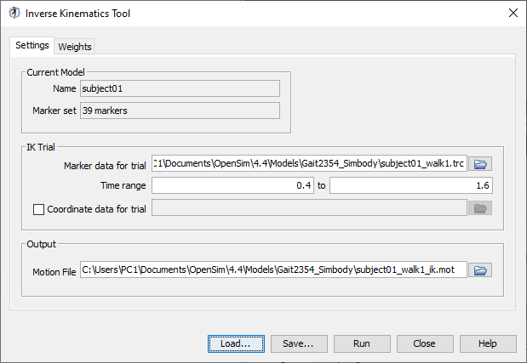
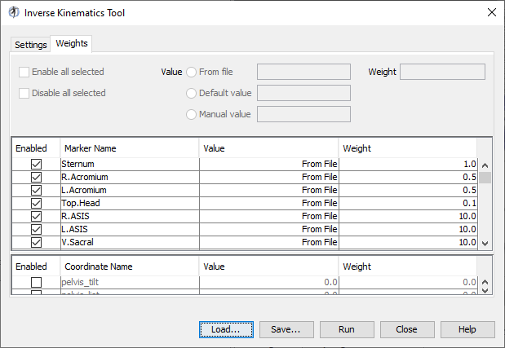
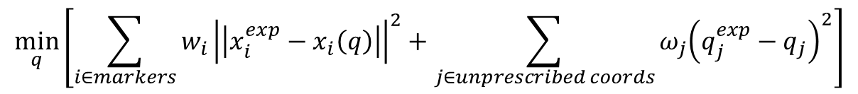
Inverse Kinematics
$$\min_{q}\left[\sum_{i∈markers}{w_{i}{\left|\left|x_{i}^{exp}−x_{i}\left(q\right)\right|\right|}^{2}}+\sum_{j∈unprescribed coords}{ω_{j}{\left(q_{j}^{exp}−q_{j}\right)}^{2}}\right]$$

Slide 22
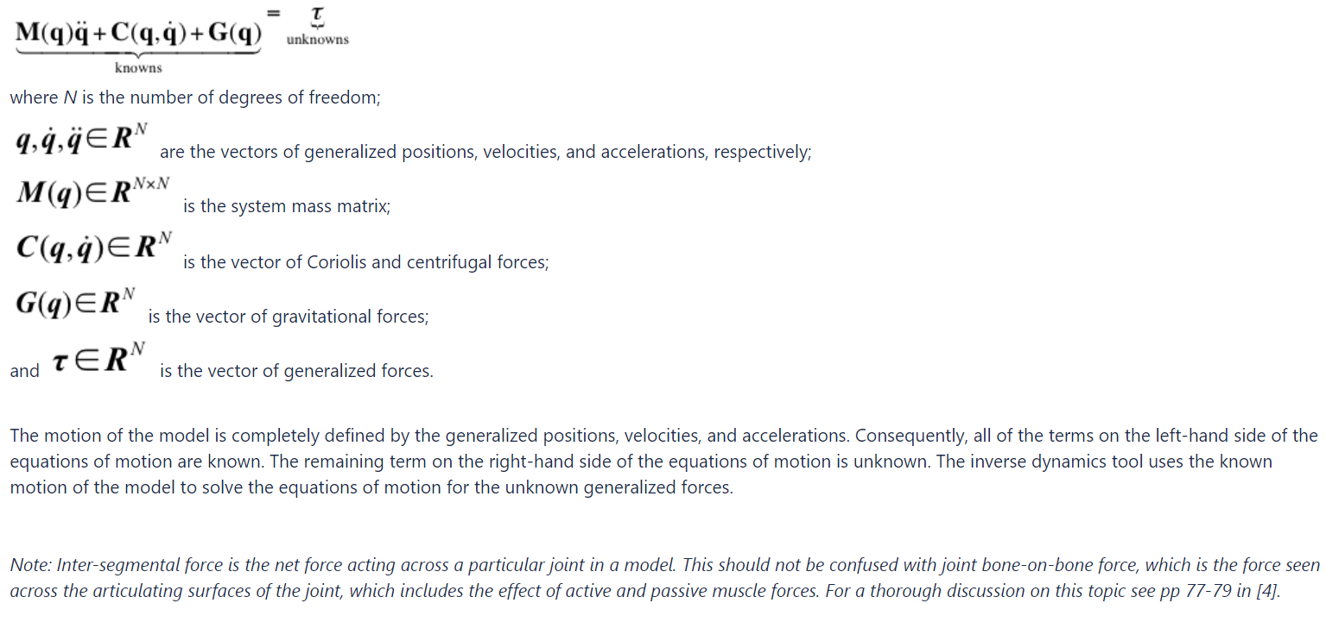
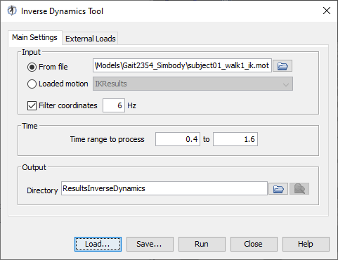
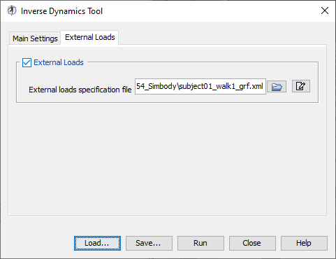
Inverse Dynamics

Slide 23
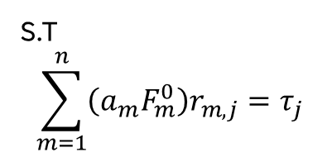
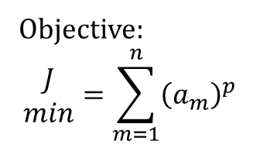
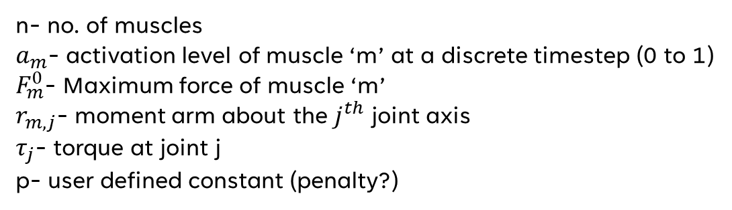
The Static Optimization Tool uses the known motion of Inverse Dynamics of the model to solve the equations of motion for the unknown generalized forces (e.g., joint torques) subject to one of the following muscle activation-to-force conditions:
Static Optimization
Objective:
$$\begin{matrix}J \\ min\end{matrix}=\sum_{m=1}^{n}{{\left(a_{m}\right)}^{p}}$$
S.T
$$\sum_{m=1}^{n}{\left(a_{m}F_{m}^{0}\right)r_{m,j}}=τ_{j}$$
n- no. of muscles
$a_{m}$- activation level of muscle ‘m’ at a discrete timestep (0 to 1)
$F_{m}^{0}$- Maximum force of muscle ‘m’
$r_{m,j}$- moment arm about the $j^{th}$ joint axis
$τ_{j}$- torque at joint j
p- user defined constant (penalty?)

Slide 24
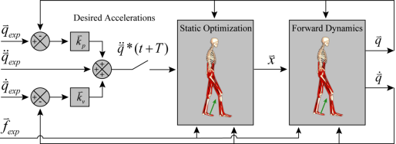
At user-specified time intervals during a simulation, the CMC tool computes muscle excitation levels that will drive the generalized coordinates (e.g., joint angles) of a dynamic musculoskeletal model towards a desired kinematic trajectory. CMC does this by using a combination of proportional-derivative (PD) control and static optimization (figure below).
Before starting the CMC algorithm, initial states for the model are computed. The states comprise the generalized coordinates (joint angles), generalized speeds (joint angular velocities), plus any muscle states (e.g., muscle activation levels and fiber lengths). While the initial values of the generalized coordinates and speeds can be taken from the desired kinematics that you specify, the initial values of the muscle states are generally unknown. To compute viable starting muscle states, CMC is applied to the first 0.030 seconds of the desired movement. Because the muscle states are generally out of equilibrium and muscle forces can change dramatically during this initial time interval, the simulation results during this interval are generally not valid. Therefore, you should be sure to start CMC at least 0.030 seconds prior to the interval of interest.
Computer Muscles Control
Static optimization is used to distribute the load across synergistic actuators. It is called "static" optimization because the performance criterion (i.e., the cost index) is confined to quantities that can be computed at any instant in time during a simulation.

Slide 25
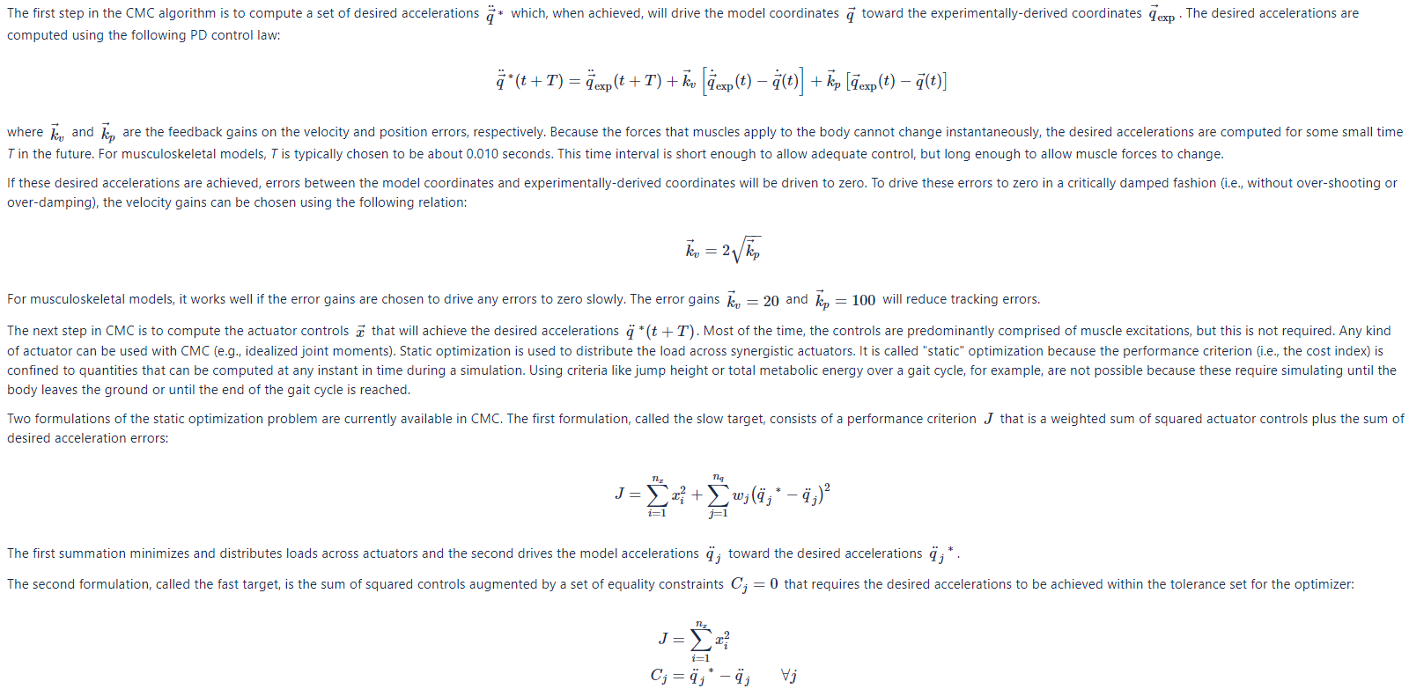

Slide 26
Physical Experiment
Patient Details
Age
Weight
FEA Model
Optical Motion Capture
EMG
(Optional)
Linear Elastic Bones
Connected by hyperelastic cartilage
And linear elastic tendons (bar element)
Encased in a hyperelastic soft tissue
GRF
MBD Model
Rigid Bones connected by joints
+
Muscles
Relative position of foot and ground
GRF
Muscle Forces
OpenSim
Abaqus
Static study for 4-6 instances of gait
Single instance of gait
No footwear in model regardless of experiment
Behaviour of footwear
Internal stresses of the foot
Joint Moments
Joint Kinematics
Muscle Forces
Gait Study
Barefoot- control run
Footwear- immediately after wearing
Footwear- after a few months
Barefoot- after a few months

Slide 27



Slide 28




Angles
Moments

Slide 29




CS- control subject
DNS- Diabetic Neuropathic Subject

Slide 30
Finite element analysis

Slide 31


Static Study
Applied at a particular instance of gait
Repeated 4-6 times for different gait instances
Muscle Forces
$$θ$$
GRF

Slide 32


5% 25% 50% 75% 90%

Slide 33







The exception
Software?
Explicit/ Implicit?
Connection between skin and bones?
Cartilage?
GRF and Ground-foot ankle applied as time varying inputs to the Talus (an internal bone)

Slide 34



Slide 35




An Explicit FEA study

Slide 36







Geometric Reconstruction of the Foot

Slide 37
THANK YOU

